Slide 1
Uber Data Analytics
Data Engineering Project – Part 3 :- Insights using BigQuery

Slide 2
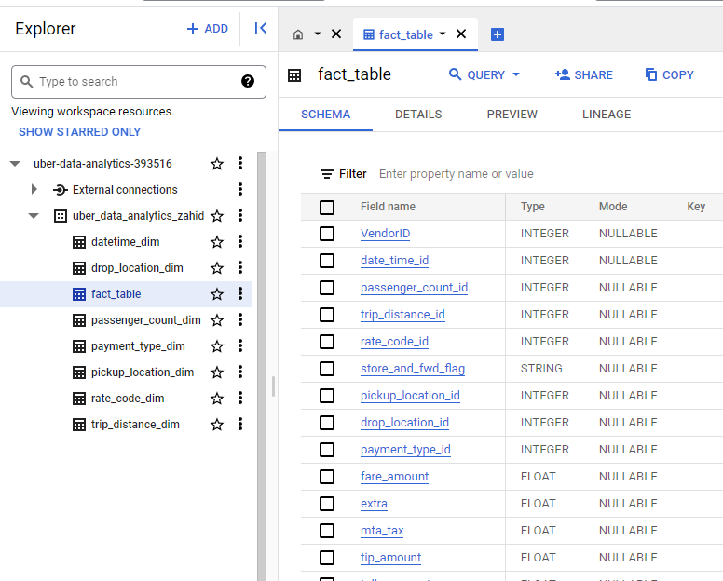
This slide shows the data after applying dimension modeling techniques.
In the previous parts of this project, we used pandas to clean and transform the flatfile data into fact and dimension tables, and then used Mage AI to perform ETL (extract, transform, and load) operations and export the data to BigQuery.
Now, we are ready to explore the data in BigQuery and discover some interesting insights.

Slide 3
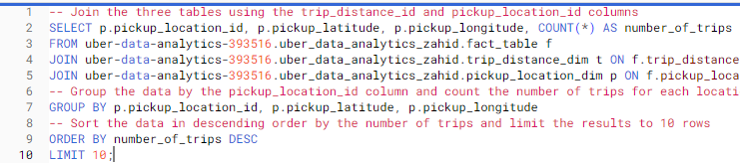
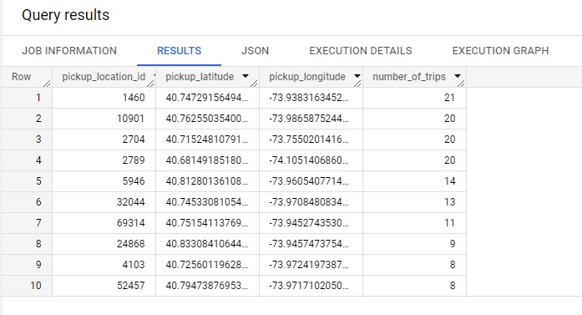
Question 1
Find the top 10 locations based on the number of trips

Slide 4
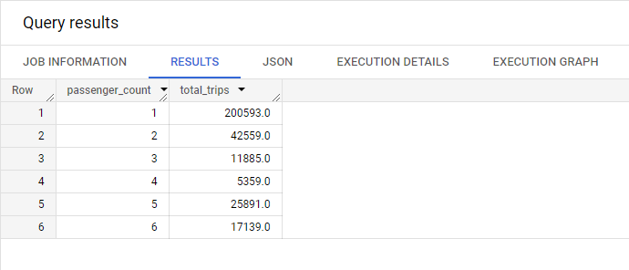
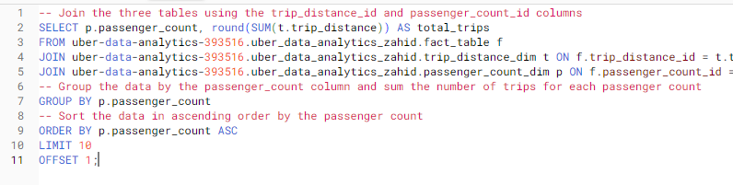
Question 2
Find the total number of trips by passenger count

Slide 5
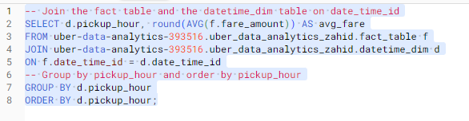
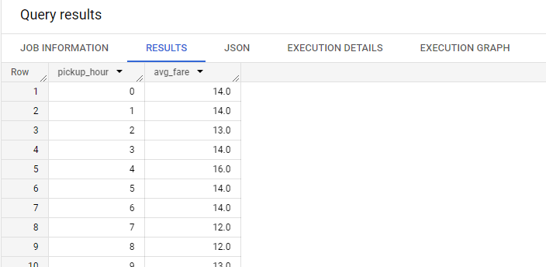
Question 3
Find the average fare amount by hour of the day

Slide 6
Thank you

